Slide 1
Quadratics

Slide 2
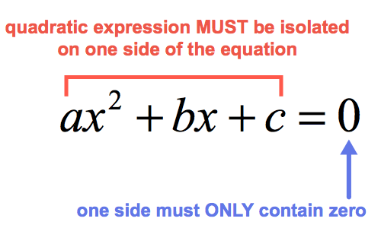
Solving quadratic equations by factorisation
(dx+f)(ex+g)=0
d*e=a
d*g+e*f=b
f*g=c

Slide 3
Solving quadratic equations by factorisation
(dx+f)(ex+g)=0
dx+f=0 → x= -f/d
ex+g=0 → x= -g/e

Slide 4
Completing the square(Бүтэн квадрат ялгах)
Answer: 3(x-2)^2-5
3(x^2-4x)+7
3(x^2-4x+4)+c x^2-4x+4=(x-2)^2
3(x-2)^2+c
c=7-12
c=-5 Анхны тэгшитгэлтэй тэнцүү болохуйцаар “c”-г олно

Slide 5
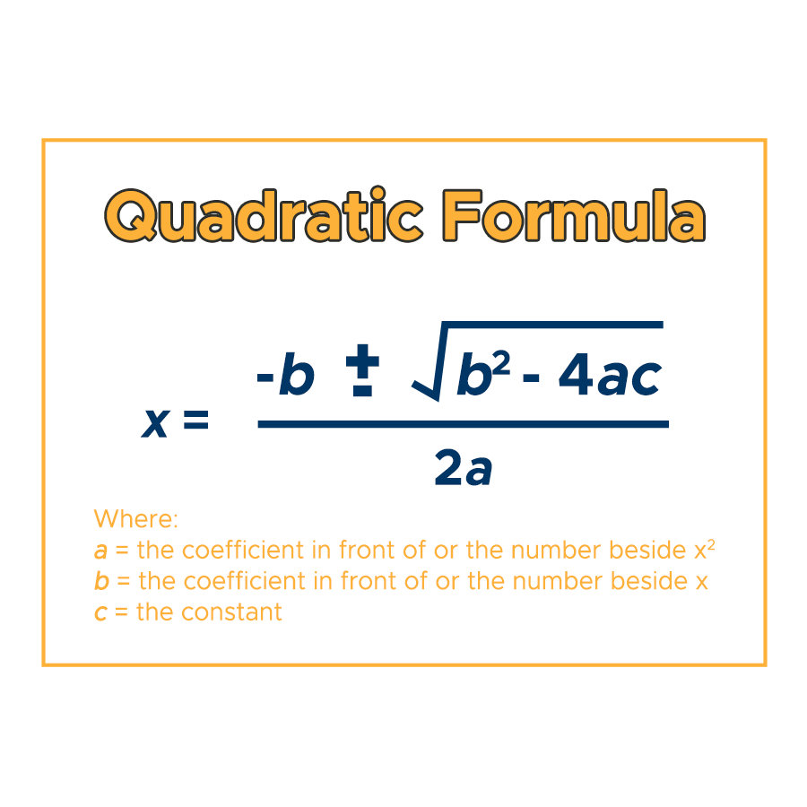
There would not be a question of this formula, but the formula is commonly used in another type of questions.

Slide 6
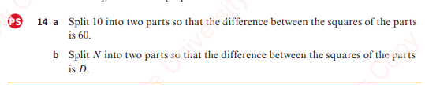
Solving simultaneous equations (one linear and one quadratic)
10=a+b
60=a^2-b^2 a=b-10
60=100-20b
30=50-10b
10b=20
b=2 a=8
You can find a solution by drawing graphs. Intersections are the solution

Slide 7
Solving more complex quadratic equations
We can replace a variable by simpler variable. (see page 16)
For example:
x^4 = y^2
Root of x = y
3^x = y

Slide 8
https://www.khanacademy.org/math/algebra/x2f8bb11595b61c86:quadratic-functions-equations/x2f8bb11595b61c86:quadratics-solve-factoring/v/example-1-solving-a-quadratic-equation-by-factoring
https://www.khanacademy.org/math/algebra/x2f8bb11595b61c86:quadratic-functions-equations/x2f8bb11595b61c86:quadratic-formula-a1/v/using-the-quadratic-formula
https://www.khanacademy.org/math/algebra2/x2ec2f6f830c9fb89:complex/x2ec2f6f830c9fb89:complex-eq/e/quadratic-formula-with-complex-solution

